Slide 1


Project ID:
SU/ FET/ IT/ FYP/ 2019/ 08
FET BASED COURSES MATERIAL MANAGEMENT SYSTEM
Group Members:
Anas Ali 2K19/IT/18 | Vinode Kumar 2K19/IT/118| Tahir Ali 2K19/IT/113|
Supervised By:
Dr Waheed Mahesar
DEPARTMENT OF INFORMATION TECHNOLOGY,
FACULTY OF ENGINEERING AND TECHNOLOGY,
UNIVERSITY OF SINDH, JAMSHORO

Slide 2
Table of contents
01
INTRODUCTION
04
TOOLS AND TECHNOLOGY
02
SCOPE OF PROJECT
05
PROPOSED METHODOLOGY
03
AIMS AND OBJECTIVES
06
ANALYSIS AND DESIGN PROGRESS TIMELINE

Slide 3
1. Introduction of Project
Students don’t have a facility to get study material related to their course.
They don’t have a platform where they can go through previous Final year project details
They had to go to the library and look for FYP details.

Slide 4
Introduction of Project Continued!
Also students of FET don’t have a facility where they can ask question/queries related to their studies and other students can reply to their questions.

Slide 5
Scope of Project
The scope of the project is to provide a platform where students can get course material of any subject, and view previous fyp projeccts.
Till now it is only for FET students , it can further be extented to Sindh University

Slide 6
3. Aim and Objectives
The Aim is to provide a platform where a student can get academic resources, theses, FYP project details and discuss their study related questions/queries with other students
To provide academic resources
To provide discussion forum for students.

Slide 7
4. Tools and Technologies
Front End
HTML
CSS
JAVASCRIPT
REACT JS
Back End
NODE JS
EXPRESS JS
MONGO DB

Slide 8
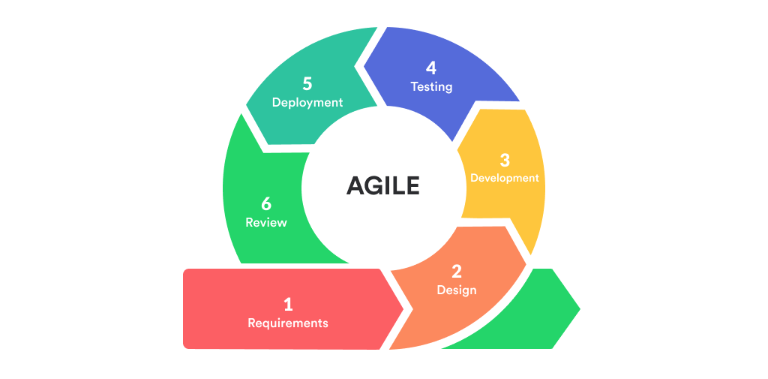
5. Methodology
AGILE DEVELOPMENT:
Agile project management divides large-scale projects into several phases, called sprints or iterations. This way, tasks are accomplished in short stages throughout the lifecycle of the project.
Figure : Agile Development

Slide 9
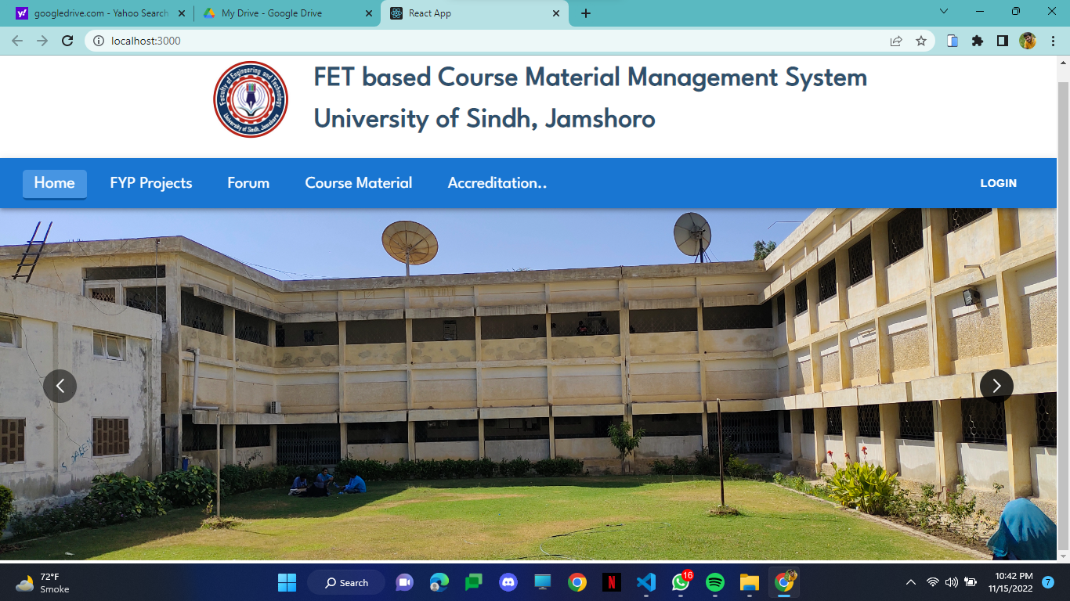
Analysis and Design Progress Timeline
1. Home Page

Slide 10
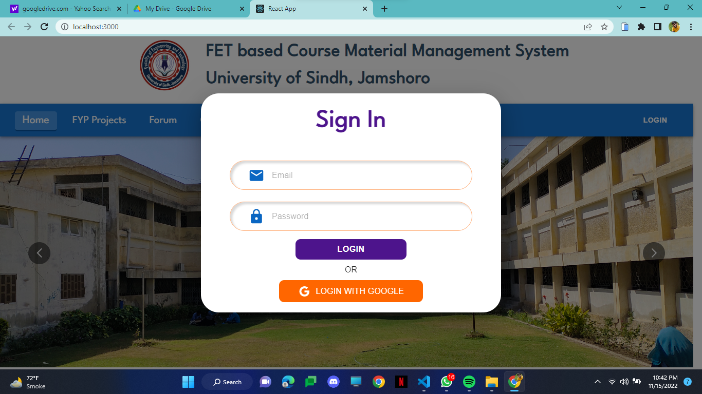
2. Login Functionality

Slide 11
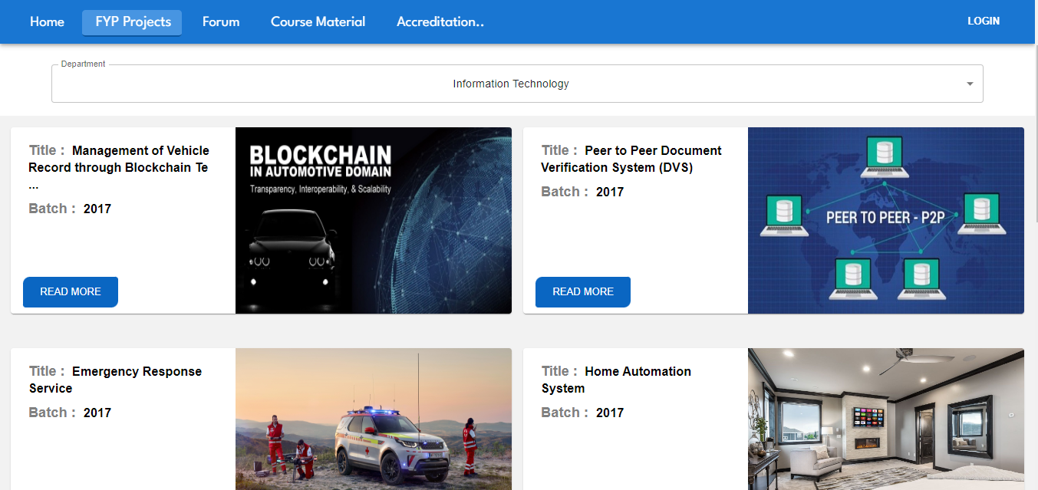
3. Project List

Slide 12
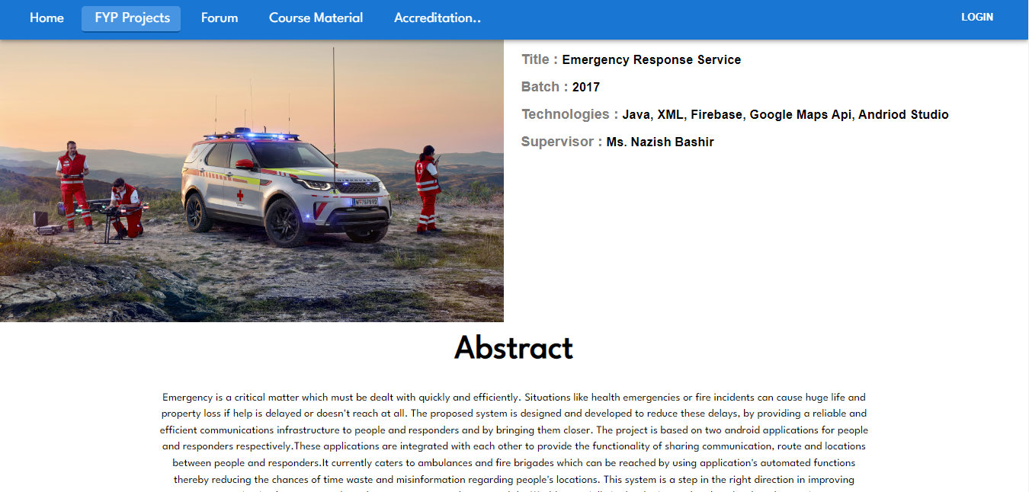
4. Project Detail

Slide 13
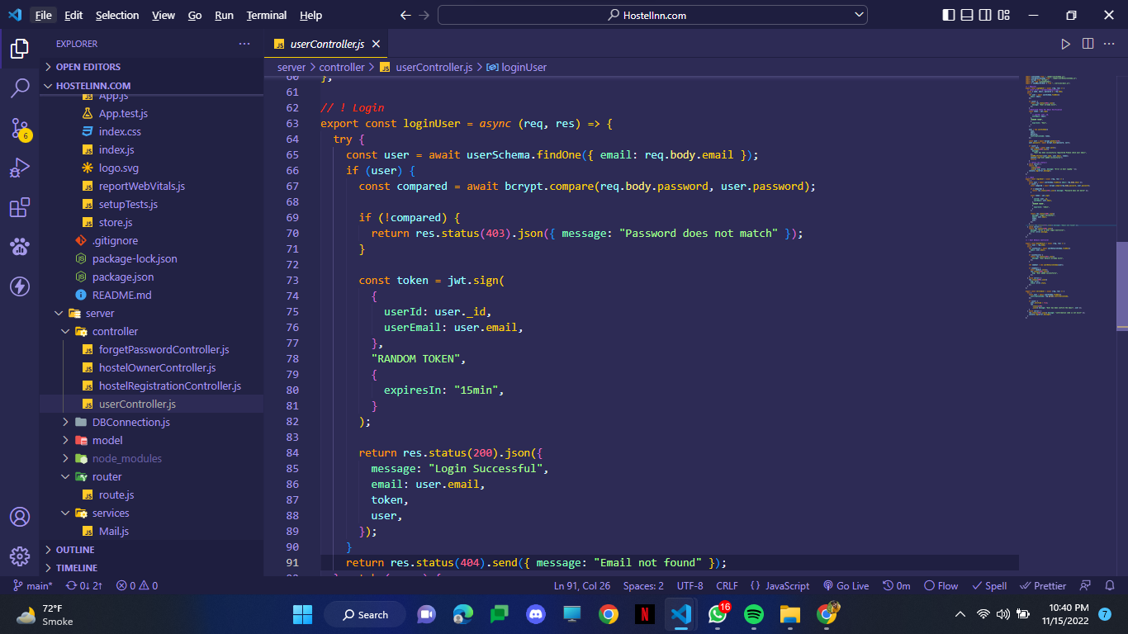
Backend
1. Login API

Slide 14
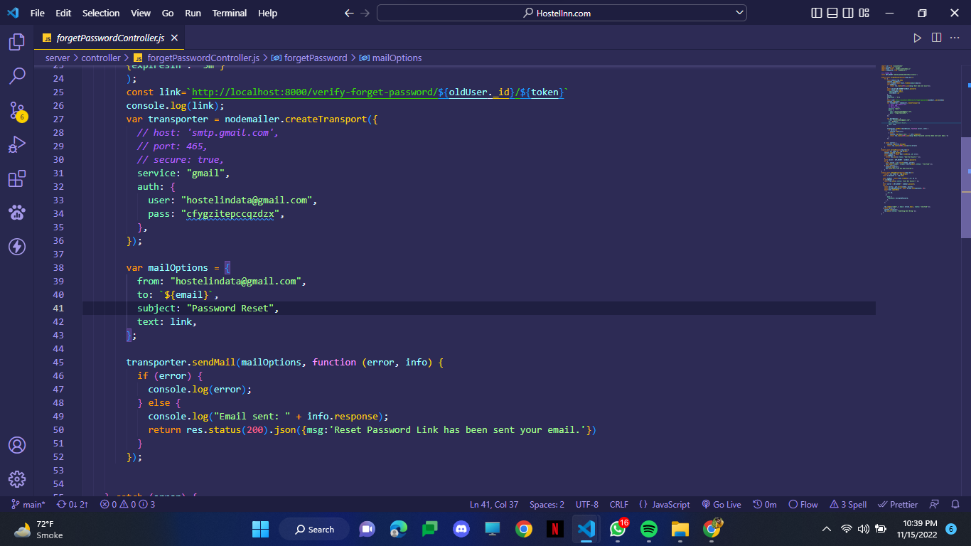
2.Forget Password API

Slide 15
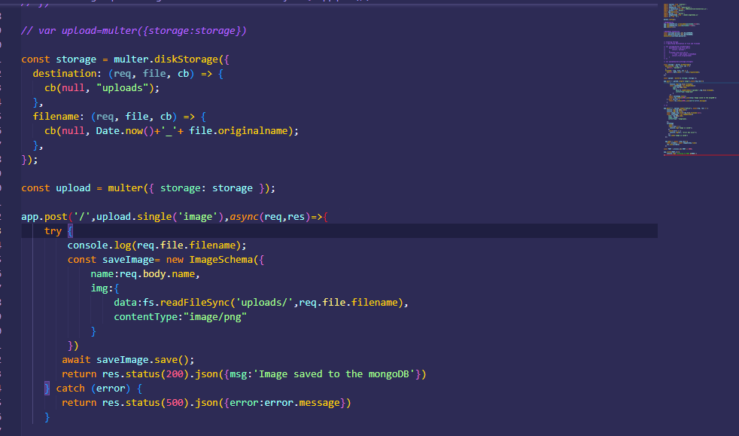
3.File Save API

Slide 16
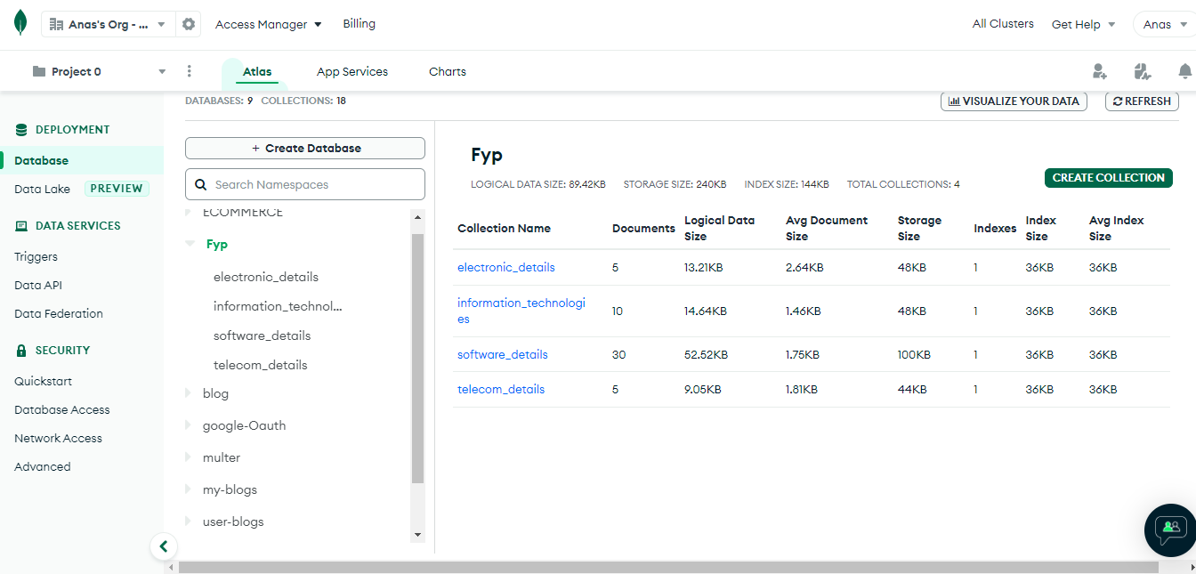
Database:

Slide 17
